Slide 1


Slide 2
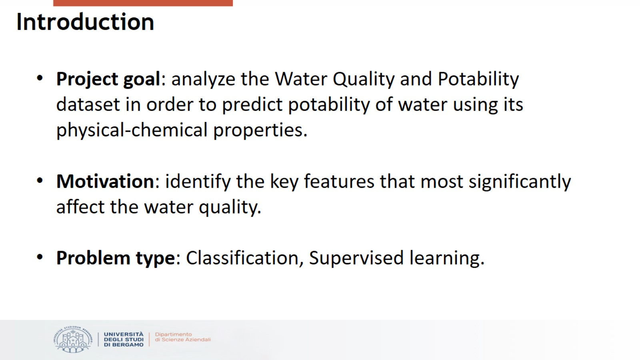
Introduction

Slide 3
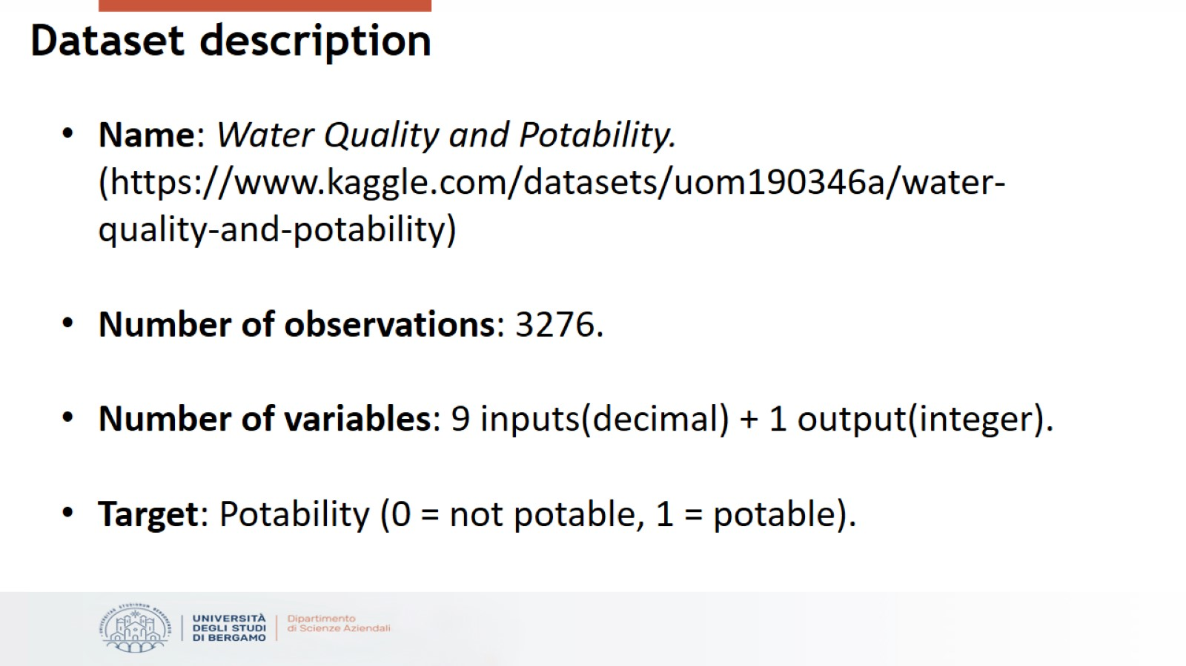
Dataset description

Slide 4
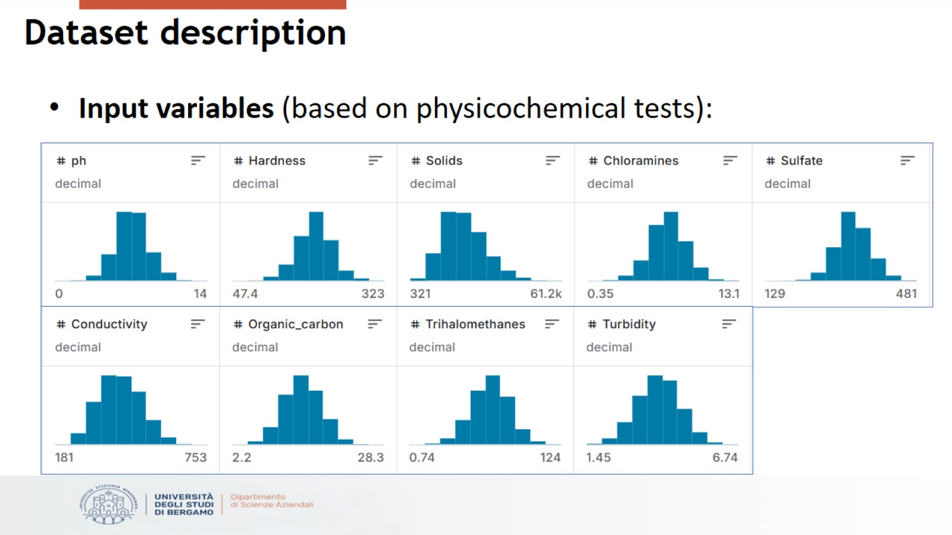
Dataset description

Slide 5
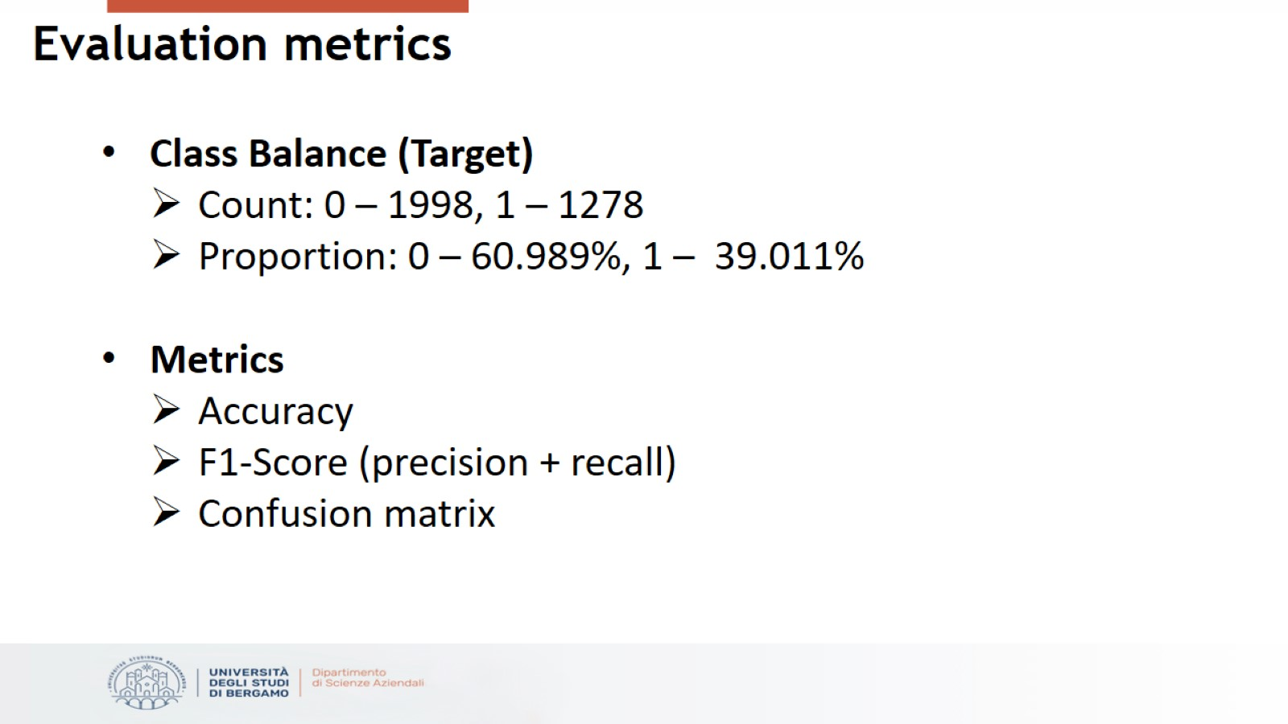
Evaluation metrics

Slide 6
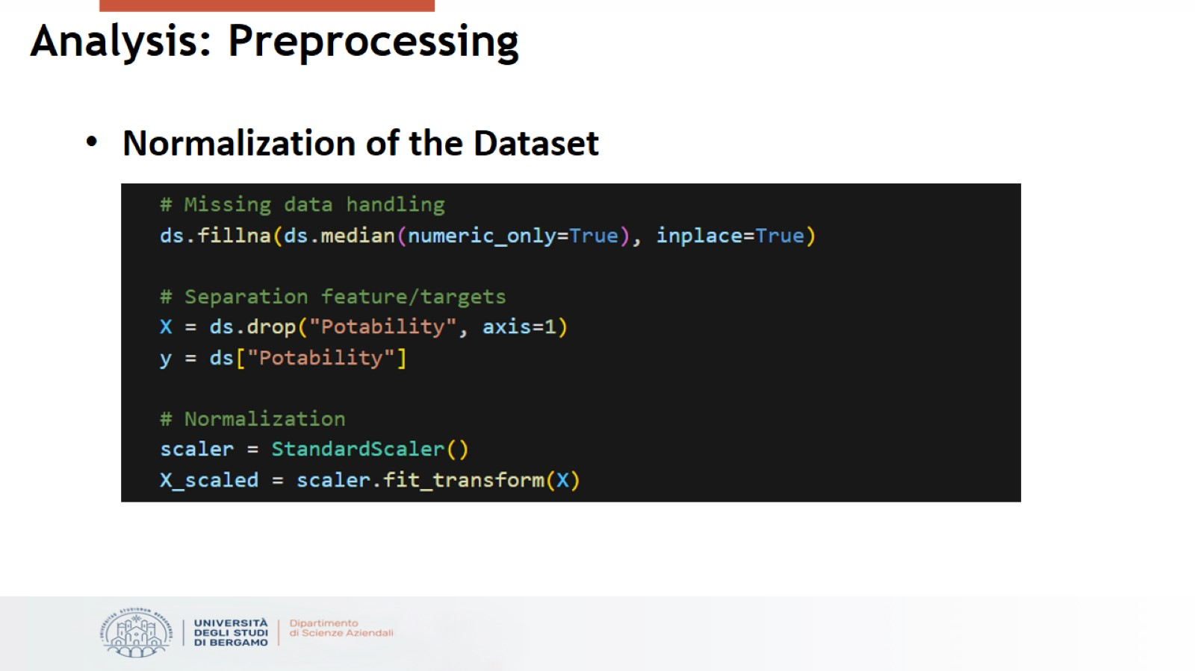
Analysis: Preprocessing

Slide 7
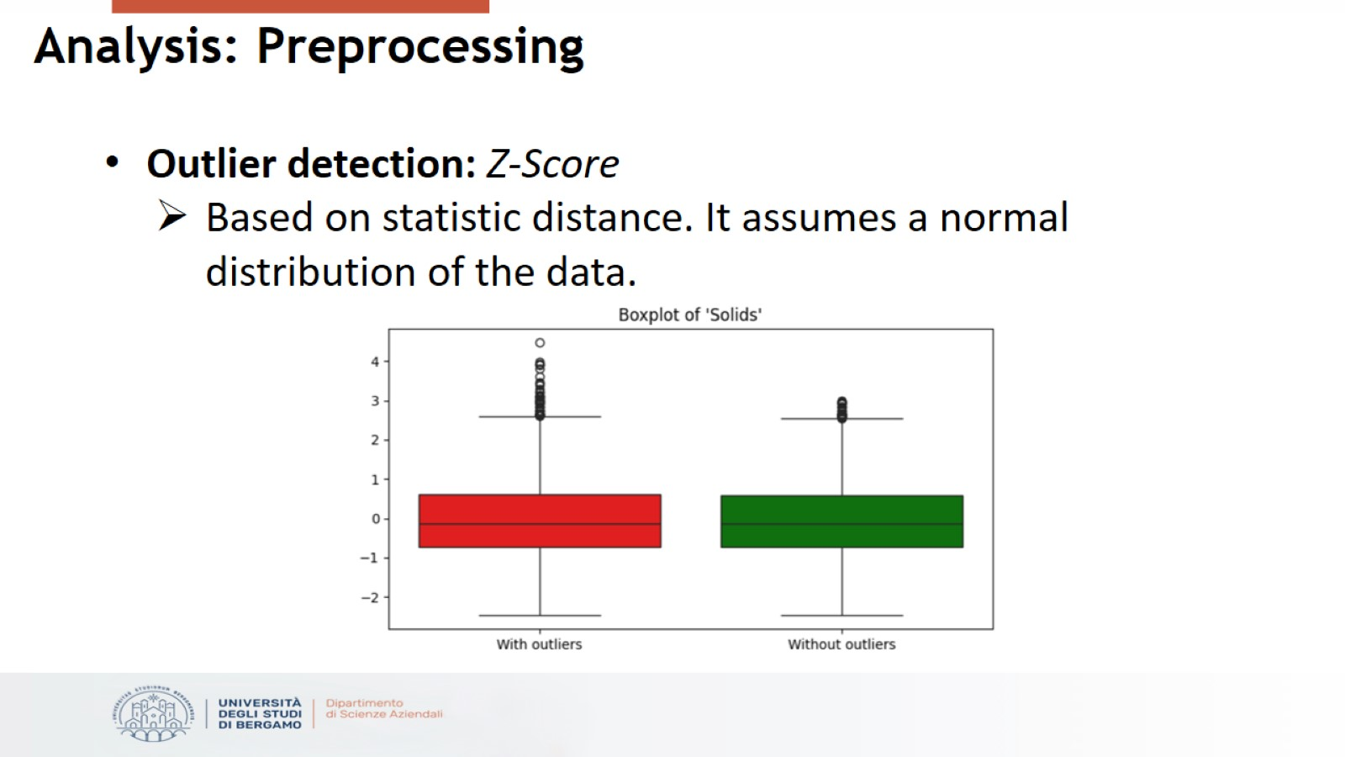
Analysis: Preprocessing

Slide 8
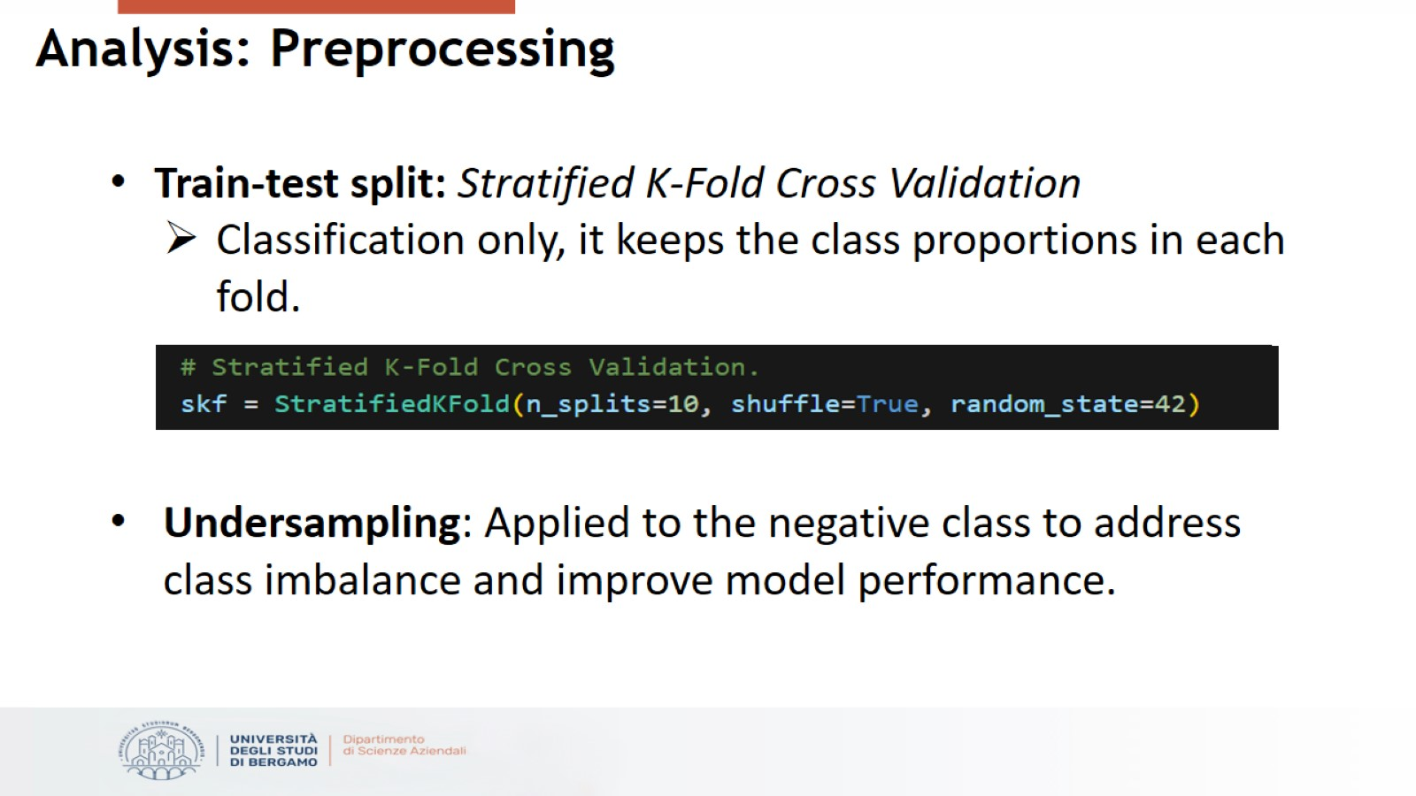
Analysis: Preprocessing

Slide 9
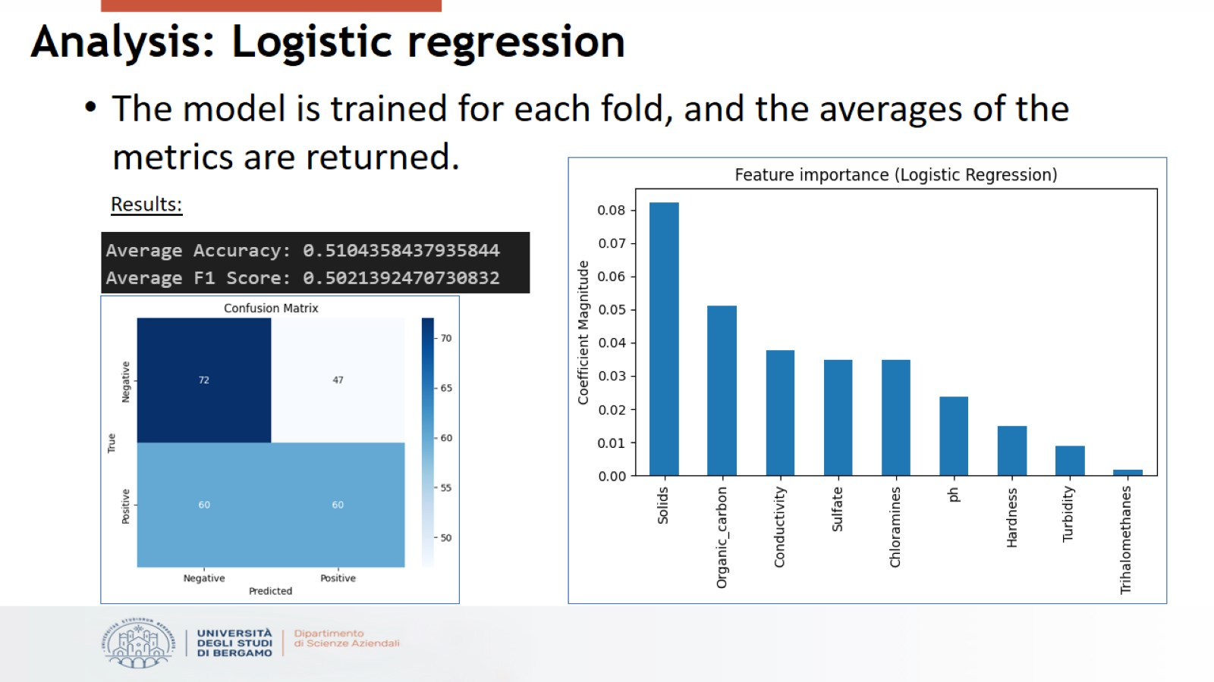
Analysis: Logistic regression

Slide 10
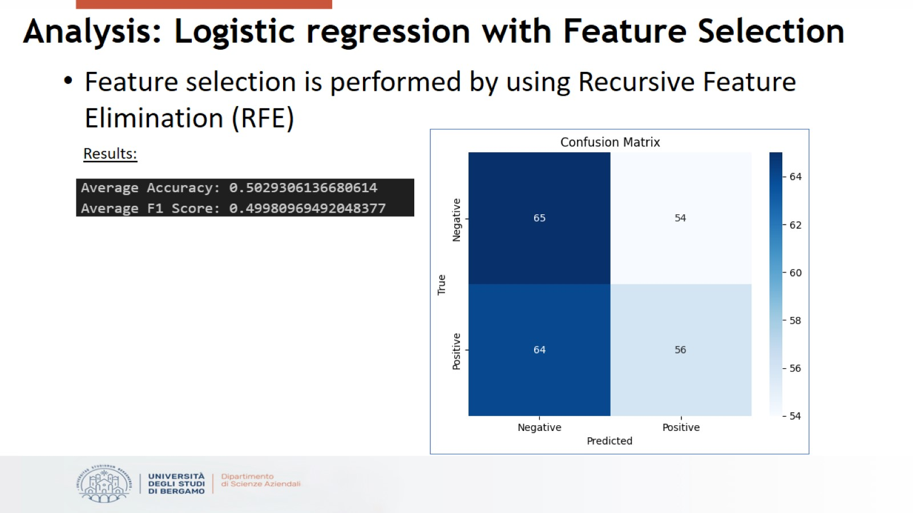
Analysis: Logistic regression with Feature Selection

Slide 11
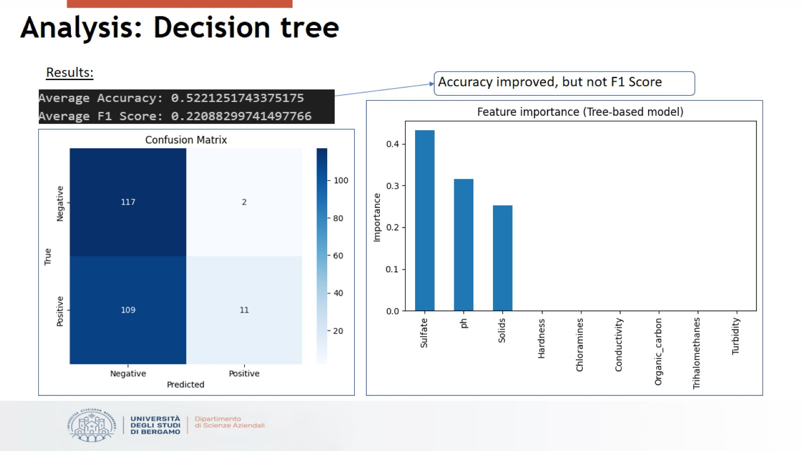
Analysis: Decision tree

Slide 12
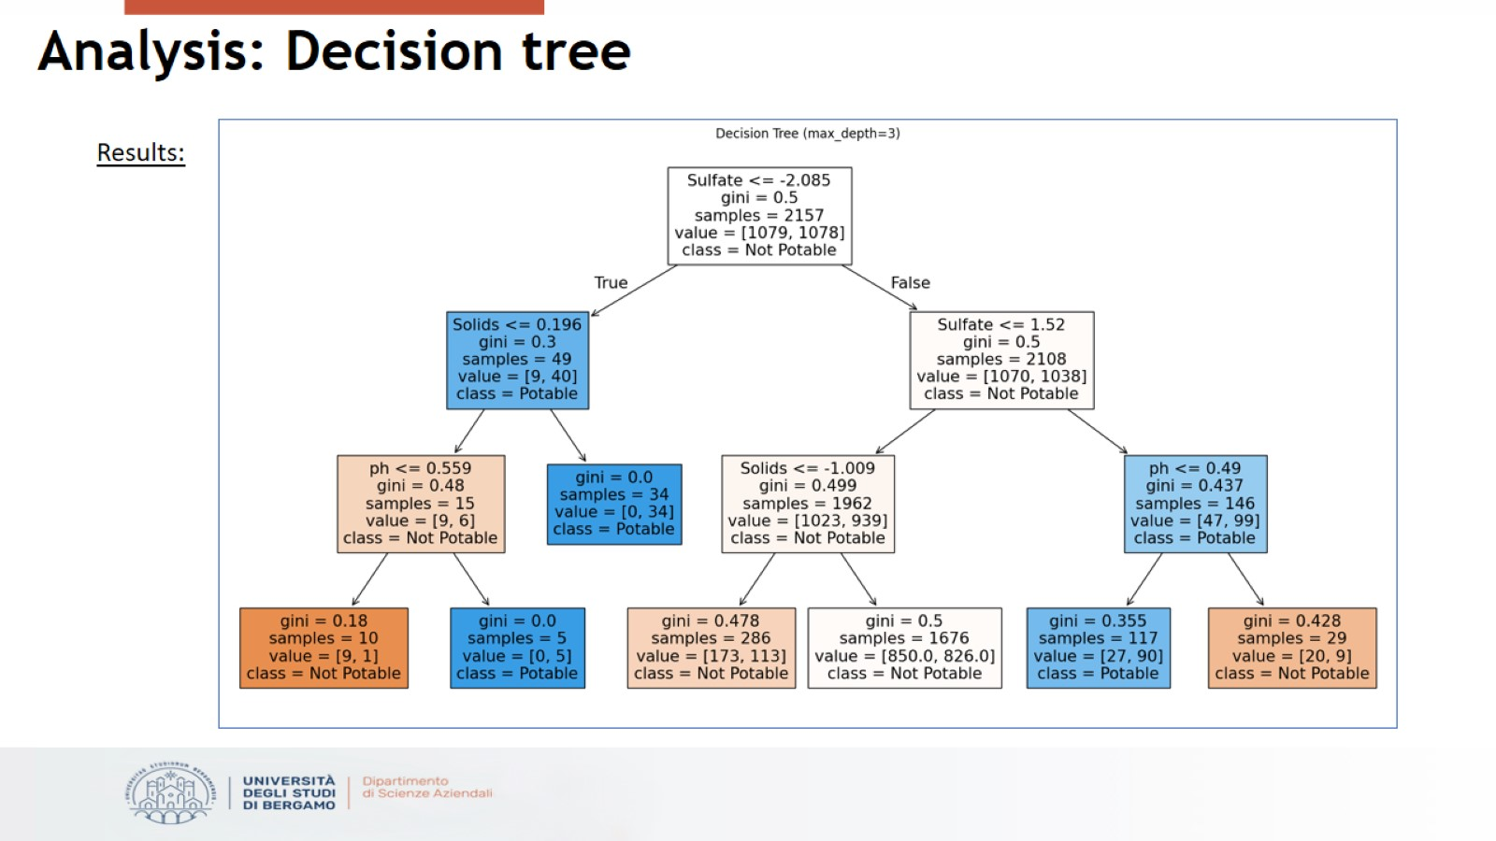
Analysis: Decision tree

Slide 13
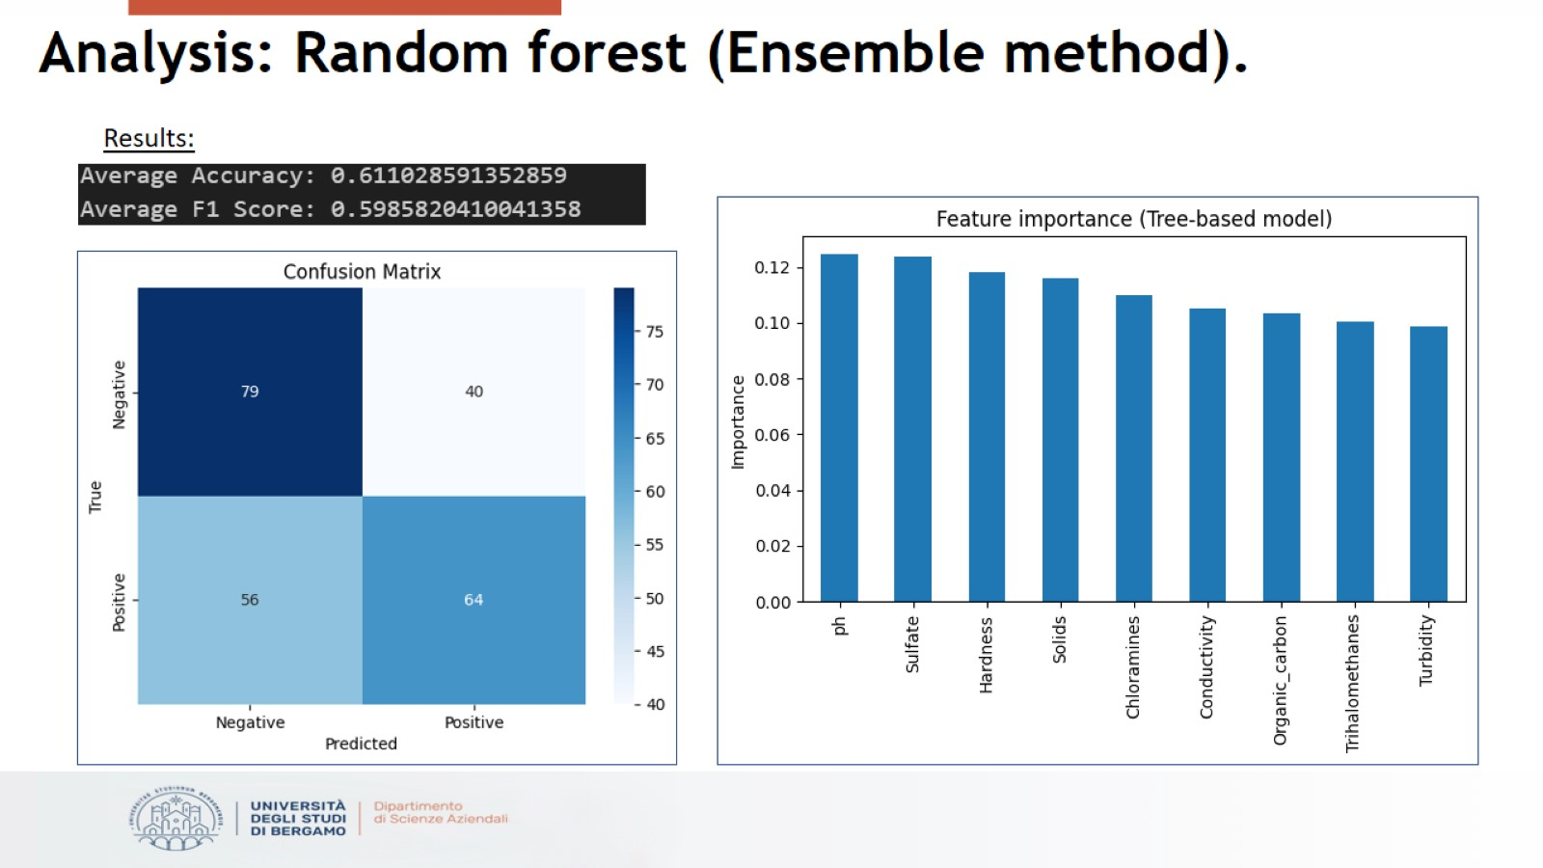
Analysis: Random forest (Ensemble method).

Slide 14
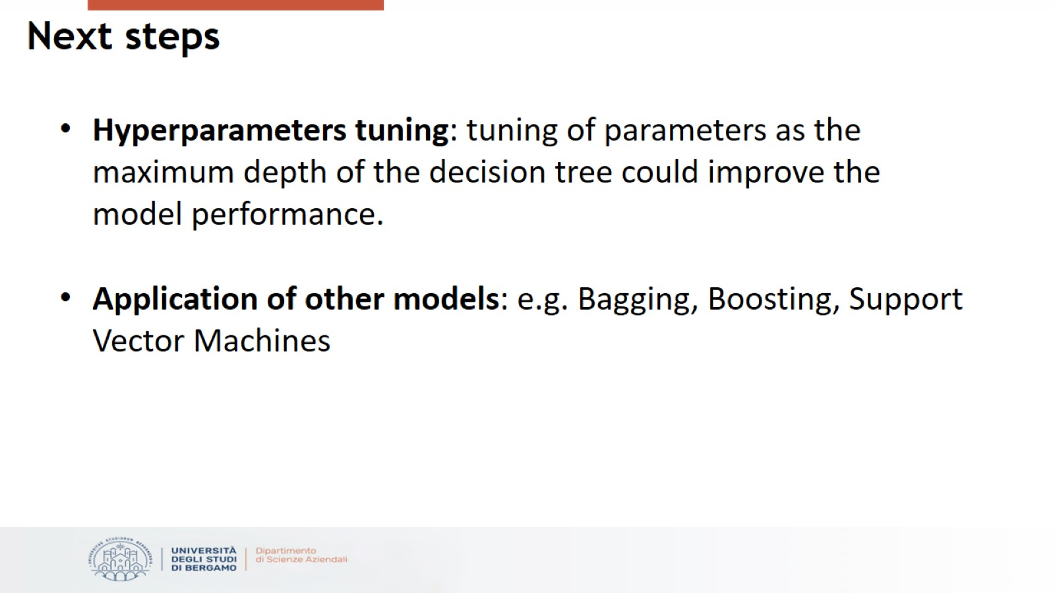
Next steps

Slide 15


